Slide 1
Rethinking Patient Safety Navigating the Measurement and Monitoring Safety Clouds: A leaders’ Self-reflection and Discussion Activity
Notes:
This slide deck has been created to support facilitation of the activity: NAVIGATING THE MEASUREMENT AND MONITORING SAFETY CLOUDS: A LEADERS’ SELF-REFLECTION AND DISCUSSION
Please refer to the activity card for more details about the activity and instructions for hosting.
Please feel free to modify this deck to suit your audience and facilitation style.
Senior leaders are key champions for Rethinking Patient Safety. This activity encourages self-reflection by senior leaders in five domains of the Measurement and Monitoring of Safety Framework (MMSF), which has formed the foundation for Rethinking Patient Safety. It is intended to support reflection and discussion around current approaches for measuring and monitoring safety in all sectors of healthcare – from acute care and rehabilitation, long term care, and care in home and community. While we have made progress on reporting and learning from harm, it is now time to maximize learning from other sources of safety information. Each dimension of MMSF is represented as a ‘safety cloud’ composed of two themes and questions to reflect on and discuss.
What are safety cloud themes?
The exercise delves into the five domains of the MMSF (past harm, reliability, sensitivity to operations, anticipation and preparedness, and integration and learning) using safety clouds. Each safety cloud contains two themes, encouraging leaders to first engage in self-reflection and then participate in reflective conversations.
The themes within each safety cloud highlight common challenges healthcare organizations may face as they shift toward Rethinking Patient Safety and refine their approach to measuring and monitoring safety.
All five domains of the MMSF and each safety theme is explained in detail in this slide deck. Some of the themes will resonate with you more than others. Your organization may have denser clouds for one or two themes.
We recommend you break down the activity into bitesize chunks. For example, you may opt to work through one safety cloud and its associated themes in each reflective leadership conversation or take one of the themes in each safety cloud and discuss it, then have a conversation about the next theme at your next Board or senior leadership meeting, retreat or in another forum. What matters is that you have an honest, open and inclusive conversation about the challenges related to each safety theme and associated question.
Do not try to have reflective conversations about all 10 themes in one session. A series of deeper, more meaningful conversations spread out over time will enable you to thoroughly explore each safety theme.

Slide 2
Outline
Introduction
Measurement and Monitoring of Safety Framework (MMSF)
Rethinking Patient Safety (RPS)
MMSF safety clouds and themes
Past harm
Theory
Reflections on current state
Theme 1: Measuring and monitoring past healthcare harm and health inequities
Theme 2: ‘System-focused’ versus ‘person-focused’ recommendations
Take-away task
Reflections on future state

Slide 3
Outline
Reliability
Theory
Reflections on current state
Theme 1: The normalization of unreliable clinical systems & processes
Theme 2: Understanding the limitations of clinical system & process audits
Reflections on future state
Sensitivity to operations
Theory
Reflections on current state
Theme 1: Capacity to tune into ‘work as done’
Theme 2: Creating psychological safety
Reflections on future state

Slide 4
Outline
Anticipation and preparedness
Theory
Reflections on current state
Theme 1: Looking at other data sets differently
Theme 2: Horizon scanning to proactively identify emerging and future safety
Reflections on future state
Integration and learning
Theory
Reflections on current state
Theme 1: Knowing learning happens
Theme 2: Preventing integration fog
Reflections on future state
Continuing your safety journey
Additional resources

Slide 5
Measurement and Monitoring of Safety Framework
The measurement and monitoring of safety – The Health Foundation
Notes:
The Measurement and Monitoring of Safety Framework serves as a conceptual model to guide healthcare organizations in their efforts to improve safety. While the nature of safety is widely discussed in the literature, there is little consensus – particularly in healthcare – about its core dimensions or what should be measured and monitored.
The framework addresses this gap by integrating all the critical dimensions of safety in one framework and providing examples of how these concepts can be applied across various health sectors, from acute care and rehabilitation, long term care, home and community care.
The MMS Framework attempted to synthesise the wider theory, literature and practice from both healthcare and other industries in a form that aimed to be accessible and useful to all healthcare organizations. The Framework comprises five dimensions or lenses on safety: past harm, reliability, sensitivity to operations, anticipation and preparedness, and integration and learning.
For more information about the MMS Framework, please refer to the link on the slide.

Slide 6
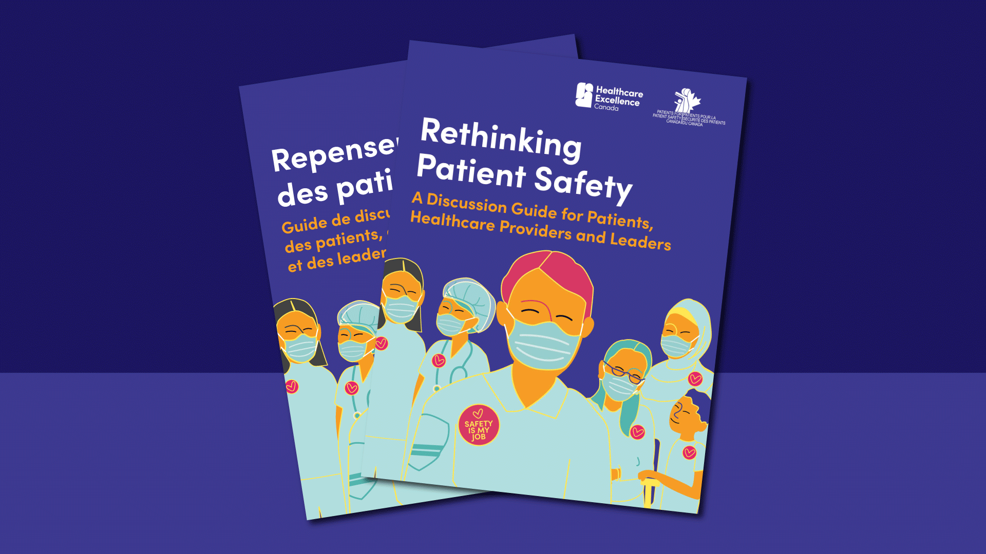
Rethinking Patient Safety (healthcareexcellence.ca)
Notes:
Like the MMS Framework, Rethinking Patient Safety (Healthcare Excellence Canada, October 2023) recognizes that safety is much more than the absence of harm. To improve patient safety, we must start by thinking and talking about it differently.
Improving patient safety requires us to look at the whole system: its past, present and future in all their complexity.
Rethinking Patient Safety was released in 2023 by Healthcare Excellence Canada. It was developed because, despite 20 years of efforts to improve patient safety, we haven’t been as successful as we had hoped. Healthcare Excellence Canada is encouraging everyone to rethink how they have been defining and approaching patient safety improvement work.
The core statement within Rethinking Patient Safety Reads:
“Everyone contributes to patient safety. Together we must learn and act to create safer care and reduce all forms of healthcare harm.”
It includes a table for reflection and a list of questions for discussion.
For more information about Rethinking Patient Safety, please refer to the link on the slide.

Slide 7





Measurement and Monitoring Safety Clouds & Safety Themes
Past harm
Measuring and monitoring past healthcare harm and health inequities.
Strong ‘system-focused’ versus weak, ‘person-focused’ recommendations
Integration
& learning
Reliability
Normalization of unreliable systems and processes
Understanding the limitations of clinical systems & process audits
Knowing how feedback and learning happens
Preventing integration fog
Anticipation
& preparedness
Sensitivity
to operations
Looking at other data sets differently
Horizon scanning to proactively identify emerging and future safety risks
Capacity to tune into ‘work as done’
Creating psychological safety when gathering insight
Notes:
Here is an overview of the five safety clouds and 10 safety themes that make up the leaders’ self-reflection and discussion activity. Each safety cloud and theme will be discussed in greater detail in the following slides.

Slide 8
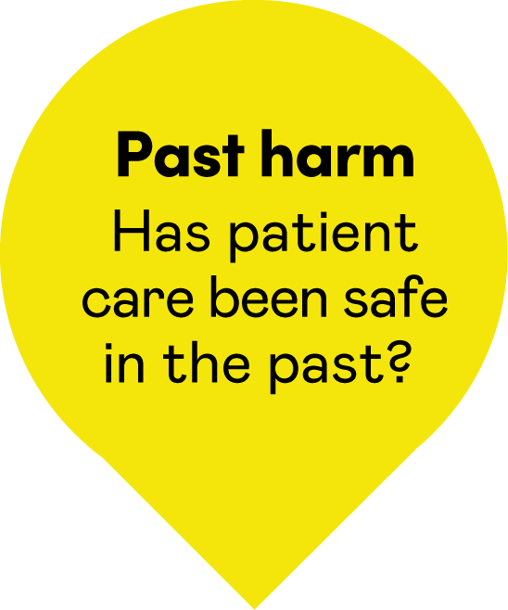
Past harm

Slide 9

Past harm: Has patient care
been safe in the past?
Past harm involves measuring multiple types and aspects of harm to help assess whether care has been safe in the past and is becoming safer.
Past harm is often referred to as “looking in the rear-view mirror”
It involves revisiting past events so we can learn and improve
Notes:
Past harm: Has care been safe in the past?
This dimension underscores that “Measuring harm is not equivalent to measuring safety but is an essential foundation”. While understanding past harm is crucial, it alone is not enough to drive meaningful improvements to safety.
In this dimension, past harm is the measurement of multiple types and aspects of harm to help assess whether care has been safe in the past and is becoming safer. For example, how long ago did the harm occur, and how much harm has there been over time?

Slide 10
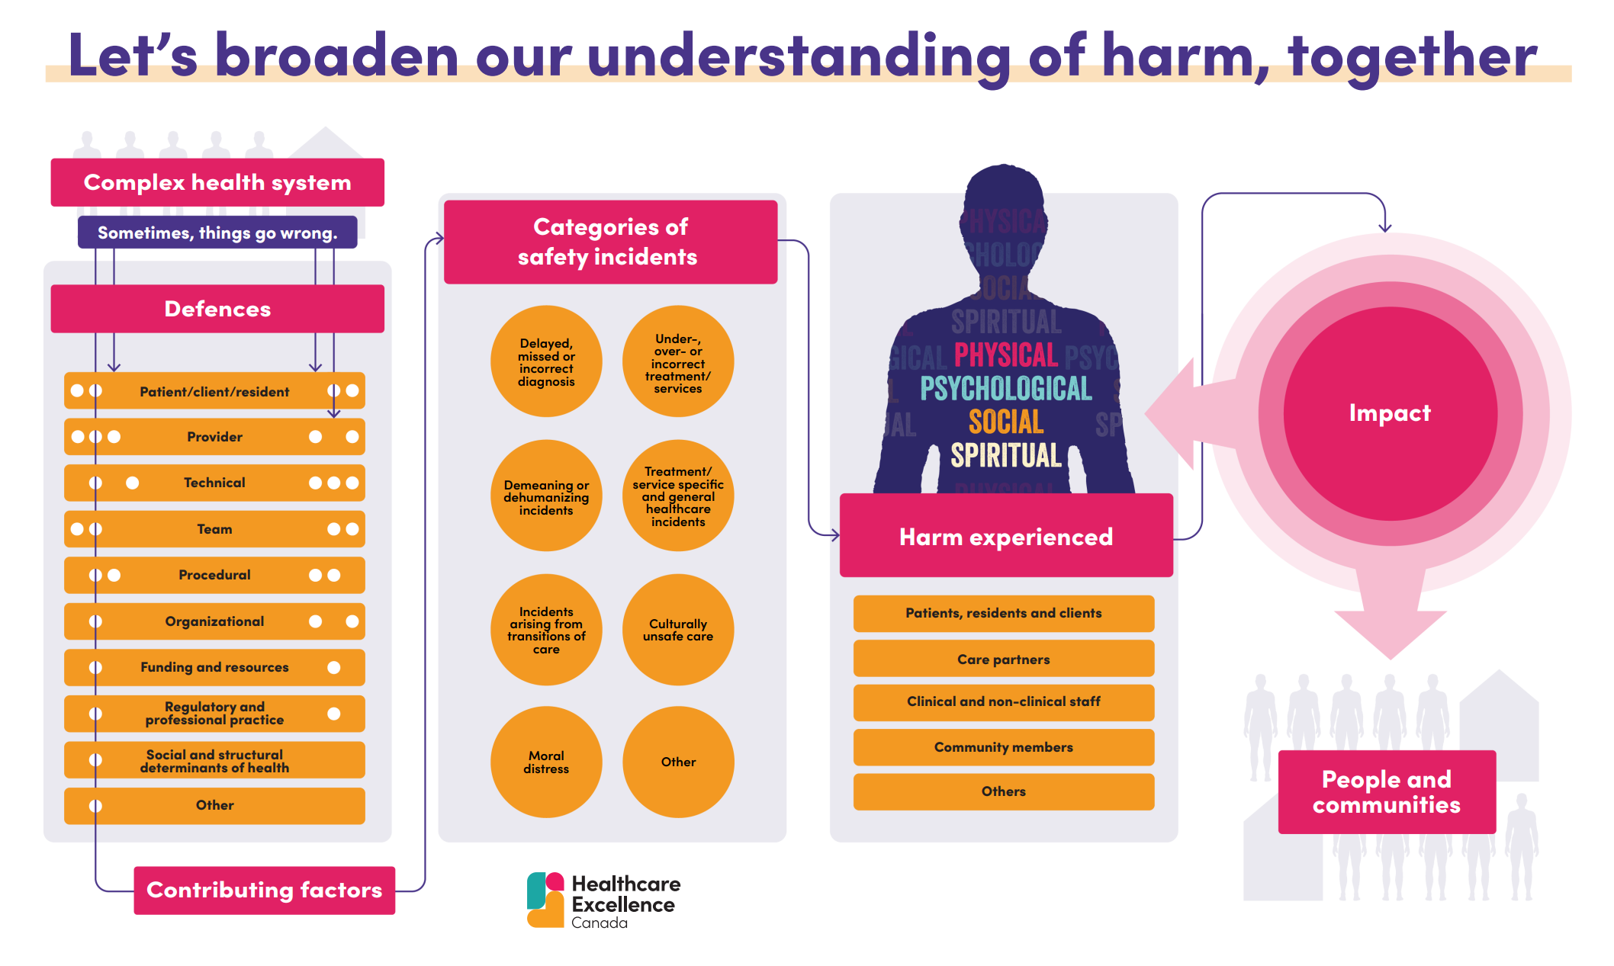
Let’s broaden our understanding of harm, together
Notes:
Recognizing and reducing healthcare harm matters to those receiving and delivering care in any setting. As part of championing Rethinking Patient Safety, everyone is encouraged to broaden their understanding of healthcare harm as an important step in delivering safer care for all.
On the screen, you will see an infographic created by Healthcare Excellence Canada that helps broaden our understanding of healthcare harm. It highlights five main concepts that we are describing:
Factors that can promote safety and factors that contribute to safety incidents and harm
Categories of safety incidents that can potentially lead to harm
The harm experienced
Who was harmed
The lasting impact of the harm on people and communities
Healthcare Excellence Canada has developed an activity to stimulate discussions and thoughtful reflections about a broader understanding of healthcare harm. You can undertake this exercise with your teams. It is available for download at Understandharm.ca

Slide 11
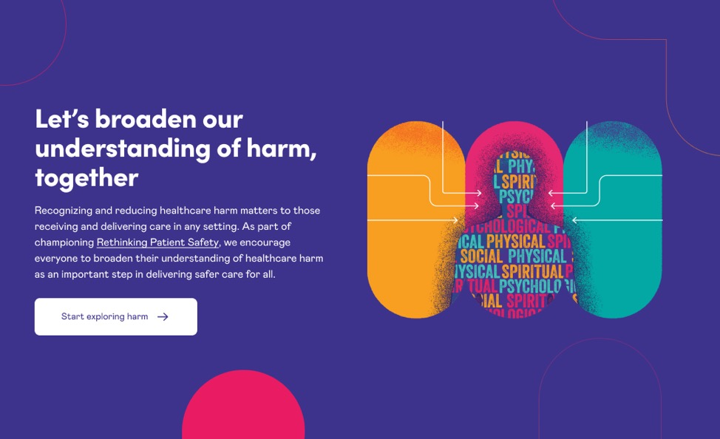
Digital infographic
UnderstandHarm.ca
Notes:
To further explore healthcare harm and learn more about five main concepts captured in the infographic, please refer to the interactive digital version available at Understandharm.ca

Slide 12
How do we currently answer the question, “Has care been safe in the past?”
Notes:
We’ve provided just a brief introduction to past harm.
Before we explore a broader view of harm and the past harm safety theme clouds, think and reflect on how we currently answer the following question, “Has care been safe in the past?”

Slide 13
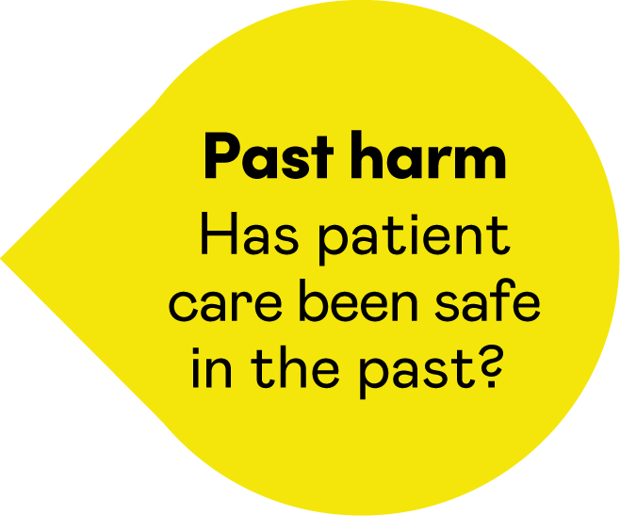
Past harm
Measuring and monitoring past healthcare harm and health inequities
Strong ‘system-focused’ versus weak, ‘person-focused’ recommendations

Slide 14
Safety cloud theme 1: Measuring and monitoring past healthcare harm and health inequities
Reflective question
How might we improve our understanding of past healthcare harm so that we know whether patients and communities with social and systemic inequities are more likely to experience healthcare harm related to patient safety incidents?

Slide 15
Safety cloud theme 1: Measuring and monitoring past healthcare harm and health inequities
Background
We know, based on evidence and the lived experiences of people and communities, that social and systemic inequities have created barriers to receiving safe and high-quality healthcare. These inequities can contribute to safety incidents, such as:
maternity and obstetric safety incidents
overuse of restraints
over sedation and tranquilization
seclusion in mental health settings
Such incidents may lead to safety incidents, which can potentially cause physical, psychological, social and spiritual harm.
Notes:
Categories of safety incidents include:
delayed, missed or incorrect diagnosis
over-, under- or incorrect treatment/services
demeaning and dehumanizing incidents
culturally unsafe care
moral distress; etc.
Refer back to slide 10, about broadening our understanding of healthcare harm, and visit Understandharm.ca for more examples of safety incidents and details about healthcare harm.
Resources and evidence to support examples related to maternity incidents, overuse of restraints, over sedation and seclusion in mental health settings:
Longwoods Videos. (n.d.). The impacts of racism on healthcare quality and safety in Canada: A case study and practical advice from Ontario Midwifery
Boakye, P. N., Prendergast, N., Bandari, B., Brown, E. A., Odutayo, A., & Salami, S. (2023). Obstetric racism and perceived quality of maternity care in Canada: Voices of Black women. Women's Health, 19(1), 1–13. https://doi.org/10.1177/17455057231199651
First Nations Health Authority. (n.d.). Remembering Keegan: A BC First Nations Case Study Reflection “Survivors have testified to abuses – including use of restraints – in these schools and hospitals. This is not abstract in the context of health services that are delivered in BC in close proximity to the 21 former residential schools and three former Indian hospitals (Coqualeetza Indian Hospital in Chilliwack, Miller Bay Indian Hospital in Prince Rupert and Nanaimo Indian Hospital in Nanaimo)” (pg. 21). (see also this CBC report)
Centre for Addiction and Mental Health (CAMH). (n.d.). Dismantling Anti-Black Racism: A strategy of fair & Just CAMH. “In a recent analysis of CAMH data, rates of restraint use were 44 per cent higher among Black patients than among white patients.” pg. 5
Black Health Alliance, Health Inequities. (n.d.). “Black Ontarians experience higher rates of restraint and confinement under the care of the mental health and addictions system.”

Slide 16
Safety cloud theme 1: Measuring and monitoring past healthcare harm and health inequities
This safety cloud theme is asking you to consider:
What does your organization’s past harm data look like, and does it give you insights into health inequities?
Can you identify specific incidents that make the issue of inequities and patient safety incidents easier to see?
How might you strengthen your organizational knowledge to gain insights into the impact health inequities have on patient safety?
Notes:
Additional questions to consider from Rethinking Patient Safety are:
What comes to mind when you think of healthcare harm?
How can action on patient safety help reduce health inequities?
How can action on health inequities help improve patient safety?

Slide 17
Safety cloud theme 2: Strong ‘system-focused’ versus weak ‘person-focused’ recommendations
Reflective question
How many recommendations from our incident investigation reports focus on improving the design of the healthcare system (i.e. system focused) and how many focus on asking point of care healthcare staff to comply, try harder or do additional tasks (i.e. person-focused)?

Slide 18

Safety cloud theme 2: Strong ‘system-focused’ versus weak ‘person-focused’ recommendations
Background
Incident investigations in healthcare often lead to ‘person-focused’ recommendations that human factors experts have found to be less effective.
Human factors research shows that when we rely solely on person-focused recommendations, the same types of incidents are likely to recur.
Designing healthcare systems to enable staff to deliver safe patient care will achieve greater improvements in safety than simply telling staff to comply, do better or do more.
Notes:
Background:
Incident investigations in healthcare often lead to what human factors experts call, “weak, person-focused” recommendations. Weak recommendations include, reminding staff to comply with safety policies and procedures, introducing more safety policies and procedures or additional safety checks. (Refer to the summary table, called Strong, moderate and weak recommendations on the next slide.)
Human factors research shows that when we rely solely on person-focused recommendations, the same types of incident are likely to recur.
Our focus needs to be on designing healthcare systems that enable staff to deliver safe patient care.
Healthcare leaders need to understand that “person-focused” solutions and recommendations are generally weaker than those that involve redesigning healthcare systems and reengineering cultures, which are the strongest. (Refer to the summary table called Strong, moderate and weak recommendations on the next slide.)
Designing healthcare systems to enable staff to deliver safe patient care will achieve greater improvements in safety than simply telling staff to comply, do better or do more.

Slide 19

Strong, moderate and weak recommendations summary table
Recommendation strength | Types
Strong | Redesign a healthcare pathway, process or other part of the work environment.
 | Engineering controls like designing in a ‘forcing function.’
 | Effect cultural improvement to develop a psychologically safe culture.
 | Redesign equipment, IT systems to improve their usability, accessibility and functionality.
 | Simplify or standardize processes, pathways or equipment.
 | Carry out usability testing (formative and summative) when implementing new equipment, workplaces or IT systems.
Moderate | Resolve equipment availability problems.
 | Resolve staffing problems.
 | Reorganize workload to address high workload or task overload.
 | Develop and deliver simulation-based training.
 | Enhance documentation or communication.
 | Eliminate or reduce distractions and interruptions.
 | Introduce a safety checklist.
 | Review rostering or the appropriateness of the staff mix.
Weak | Add in additional safety checks for staff to carry out.
 | Raise staff awareness of a policy or process.
 | Carry out an audit or review.
 | Increase staff supervision.
 | Informing, notifying, issuing warnings.
 | Discipline or suspend staff who make errors .
 | Rewrite safety policies and procedures.
 | Introduce more safety policies and procedures.
 | Check staff understanding of safety processes (without considering how work is actually done).
 | Share the investigation findings.
 | Carry out didactic training which involves reminding staff about safety policies and procedures, or ‘counselling’ staff about the way to deliver safe patient care.
 | Other recommendations which do not take account of the workflow and task demands in a clinical area.
Notes:
Facilitator notes: Explain that the table on the slide has been developed based on research that shows some types of recommendations are weaker than others. When recommendations from incident investigation reports are “person-focused” they are weak because the underlying design flaws and systems weaknesses are not resolved. Relevant research papers on which the table is based are:
Hibbert, Thomas, Deakin et al (2018). Are recommendations from root cause analysis effective and sustainable. An observational study. International Journal of Quality in Health Care, 30; 124-131
Cafazzo and St Cyr (2012), From discovery to design: the evolution of human factors in healthcare. Healthcare Quality, 2012:15 Spec No:24-9. doi: 10.12927/hcq.2012.22845.
Another resource to reinforce this point: To Improve Health Care, Focus on Fixing Systems – Not People, by Mate, Clark and Salvon-Harman, Harvard Business Review (July 12, 2024). https://hbr.org/2024/07/to-improve-health-care-focus-on-fixing-systems-not-people

Slide 20
Healthcare Organization A's breakdown of strong, moderately strong, and weak recommendations from incident investigation reports
Strong
System-focused
Moderate
System-focused
Moderate
Weak
Person-focused
Notes:
The slide shows the mocked up organizational profile, which is typical of what we see when we carry out an analysis of recommendations in incident investigation reports.
Share some examples of the weak, person-centred recommendations, the moderate and strong “system-focused” recommendations when you introduce the task.
Then ask those participating to discuss the reflective question, “How many of the recommendations from our incident investigation reports focus on improving the design of the healthcare system (i.e. system focused) and how many focus on asking point of care healthcare staff to comply, try harder or do additional tasks (person-focused)?”

Slide 21
Safety cloud theme 2: Strong ‘system-focused’ versus weak ‘person-focused’ recommendations
This safety theme cloud is asking you to:
Review the mocked-up profile for Organization A and the table’s examples of weak, moderate and strong recommendations.
As a leader, reflect on the recommendations in your organization’s incident investigations.
What would your organization’s profile look like?
What needs to change?
Notes:
The question is asking you, as a leader, to consider the recommendations put forward in the organization’s incident investigations. Look at the mocked-up profile for Organization A and the table of what has been deemed weak, moderately strong and strong recommendations (previous slides) . What would your organizational profile look like? What needs to change?

Slide 22

Take-away task
Source five recently completed incident investigation reports from your organization.
Read the recommendations section of the report.
Do the recommendations match your perception of your organization’s focus (i.e. are they mainly person-focused or system-focused)?
Any surprises?
Notes:
We have added a takeaway task to this exercise. Ask the leaders who participated in the reflective exercise to review five incident investigation reports from their organization. The task is to consider whether their perceptions of the strength of the recommendations in these reports align with their views shared during the reflective exercise. Were there any surprises?
Carrying out the takeaway task may confirm that they, as leaders, need to support those leading investigations to reconsider the types of recommendations put forward. How might they do that?

Slide 23
How can we better answer the question, “Has care been safe in the past?”
Notes:
Now that you have explored a past harm, been introduced to a broader view of healthcare harm and completed the two “past harm” safety theme clouds:
Refer to your notes from the discussion on - How do we currently answer the question “Has care been safe in the past?”
Think and reflect on the question - How can we better answer the question “Has care been safe in the past?”

Slide 24
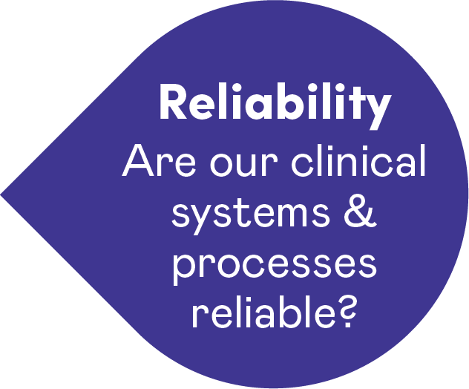
Reliability

Slide 25


Reliability: Are our clinical systems and processes reliable?
Reliability gauges the probability that a task, process, intervention or pathway will be carried out or followed as specified.
What would happen if we had a system of only measuring the number of people who fell through the ice rather than measuring the thickness of the ice?
Notes:
Reliability: Are our clinical systems and processes reliable?
This dimension really poses the question: are our clinical systems and processes reliable and, if they are not, what might that mean for the safety of the patient?
What is Reliability?
“Failure-free operation over time” applies mostly in technology.
Reliability gauges the probability that a task, process, intervention or pathway will be carried out or followed as specified.
In healthcare, we must recognize that variation is necessary due to differences in patients and care environments; treatments are adapted to fit patient needs
Sources of poor reliability include staff skills and experience, team factors such as poor communications, and inadequate design of clinical environments and supports systems, and the belief among clinical staff that improving unreliable systems is someone else’s responsibility.
Examples of Reliability measures:
hand hygiene
the timely administration of pre-operative antibiotics
the timely ordering of diagnostic tests
medication review and reconciliation
surgical checklists
availability of clinical information and patient records
availability and efficient functioning of equipment
administration of radiotherapy
availability of supplies
on-time visits
continuity of care- how often patients/clients receive care from the same provider
completion of staff training/continuing education

Slide 26
How do we currently answer the question “Are our clinical systems and processes reliable?”
Notes:
Think and reflect on the question, “Are our clinical systems and processes reliable?”

Slide 27
Reliability
Normalization of unreliable systems and processes
Understanding the limitations of clinical systems and process audits

Slide 28
Safety cloud theme 1: Normalization of unreliable clinical systems and processes
Reflective questions
Which clinical systems and processes in your organization are like a dripping tap that never gets fixed?
Why are they not fixable?

Slide 29
Safety cloud theme 1: Normalization of unreliable clinical systems and processes
Background
Unreliable clinical systems and processes can sometimes create safety risks.
Examples include:
booking systems that create unworkable schedules for staffing, clinics and operating rooms
multiple patient information systems that do not talk to each other
equipment that is unavailable or not working when needed
work environment-related problems like poor wi-fi connectivity
Notes:
Unreliable clinical systems and processes can sometimes create safety risks:
Examples include booking systems that create unworkable schedules for staffing, clinics and operating rooms.
Other types of unreliable clinical systems include multiple patient information systems that do not talk to each other, equipment that is unavailable or not working when needed, and work environment-related problems like poor wi-fi connectivity

Slide 30
Safety cloud theme 1: Normalization of unreliable clinical systems and processes
This safety theme cloud is asking you:
What systems and processes in your organization are tolerated, worked-around and have become normalized?

Slide 31
Safety cloud theme 2: Understanding the limitations
clinical system & process audits
Reflective question
When we review audits of clinical processes and systems, do we critically examine the potential negative side effects and limitations of the audit approach?

Slide 32
Safety cloud theme 2: Understanding the limitations
clinical system & process audits
Background
Healthcare audits that measure percentage compliance based on documented patient records may create a false sense of compliant behaviour.
Examples include:
High compliance rates for completion of client care plans, falls risk assessments or the Surgical Safety Checklist, which may not reflect the quality of their implementation
Documentation of vital signs, pressure-injury prevention and other care bundles that may prioritize record keeping over actual practice
Hand hygiene audits where staff are aware the auditor has come to observe their practice

Slide 33
Safety cloud theme 2: Understanding the limitations of
clinical system & process audits
This safety theme cloud is asking:
How can you, as leaders, ensure that safety audit data accurately reflects the quality of care delivered, rather than just measuring what is documented or observing behaviour that may be altered because staff are aware they are being observed?
How can you, as leaders, use the practice of inquiry to gain insights into the reliability of your clinical systems and processes?

Slide 34
How can we better answer the question, “Are our clinical systems and processes reliable?”
Notes:
Now that you have explored reliability, and have completed the two “reliability” safety theme clouds…
Refer to your notes from the discussion on - How do we currently answer the question “Are our clinical systems and processes reliable?”
Think and reflect on the question - How can we better answer the question “Are our clinical systems and processes reliable?”
When looking at improving your measures of reliability some things to consider are:
Standardization of measures – is everyone measuring the same thing in the same way.
Do our measures of reliability measure what we intend for them to measure, or are they audits of documentation?
Are you consistent in your approach to reliability – not yes/no but is everyone going deeper into the details of the process?
Are your measures of reliability customised to local settings and circumstances e.g., reliability measures specific to mental health likely differ from those in ICU which will differ from those in primary/community care
Auditing vs coaching – if you are looking to improve practice or behaviour would you rather be audited or coached?
Explore the concept of “work as imagined” vs “work as done”
Staff often accept unreliable processes as just part of the job…often pride themselves in work arounds they develop.

Slide 35
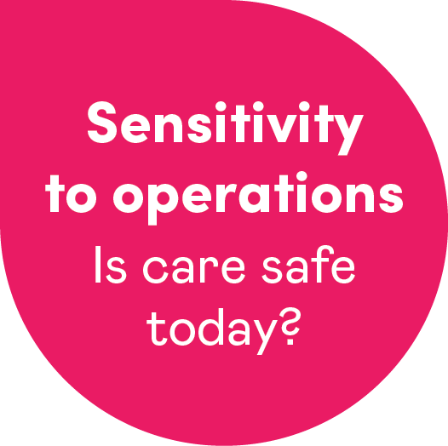
Sensitivity to operations

Slide 36



Sensitivity to operations: Is care safe today?
Observing
Listening
Perceiving
Sensitivity to operations concentrates on the day-to-day, hour-by-hour and even minute-by-minute management of safety.
It involves capturing safety intelligence through observing, listening and perceiving the healthcare setting and then acting on the information you have gathered.
Notes:
Sensitivity to Operations asks the question: Is Care safe today? This domain concentrates on the day-to-day, hour-by-hour and even minute-by-minute management of safety.
It involves capturing safety intelligence through observing, listening and perceiving the healthcare setting and then acting on the information you have gathered.
This is where we start to introduce a new approach to safety. Over the past 20 years we have focused largely on past harm and reliability … the things we can count and measure. But what about those safety-critical elements that we can not measure? This domain places value and emphasis on informal safety intelligence gathered from observations, intuition, critical thinking, experience, relationships and conversations.
Sensitivity to operations is really about continuously assessing if care is safe today so we can act upon safety in real time. The approach emphasizes creating safety proactively rather than reacting and responding after harm has happened.

Slide 37
Is care safe today?
Individual:
Monitor patients, residents, clients and care partners, watching for subtle signs of behaviour change, deterioration or improvement.
Team:
Monitor teams for signs of absenteeism, apathy, discord, fatigue or lapses in standards.
Organization:
Be alert to the impact of staff shortages, staff health and wellbeing, availability of tools to do the work, equipment breakdowns, sudden increases in demands and a host of other potential problems.
Act on the information you have gathered!
Notes:
When looking at individual Behaviour change, think about – social, emotional, physical, activities of daily living.
Deterioration – think of physical and cognitive

Slide 38
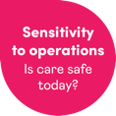
How do we build sensitivity to operations?
Observation activity
Safety walking rounds
Operational meetings, structured handovers and rounds
Safety tickets
Briefings and debriefings
Safety conversations with staff and patients
Patient interviews
Safety huddles

Slide 39
How do we currently answer the question, “Is care safe today?”
Notes:
Following a brief introduction to “Sensitivity to Operations”,
Think and reflect on the question “How do we currently answer the question “Is care safe today?”

Slide 40
Sensitivity
to operations
Capacity to tune into ‘work as done’
Creating psychological safety when gathering insight

Slide 41
Safety cloud theme 1: Capacity to tune into ‘work as done’
Reflective questions
How do we, as leaders, capture insights into “work as done?”
What else could we do to learn from what we see, hear and perceive (i.e. insights may not be easily quantified)?

Slide 42
Safety cloud theme 1: Capacity to tune into ‘work as done’
Background
By ‘work as done’, we mean how healthcare is delivered on an hour-by-hour, shift-by-shift basis.
We gather important insights into safety through:
conversations
observations
listening
tuning into how care is delivered
What we see, hear and perceive is as important as metrics we count and report.
Notes:
By “work as done” we mean how healthcare is delivered on an hour-by-hour, shift-by-shift basis. The Measurement and Monitoring of Safety Framework tells us that we gather important insights into safety through conversations, observations, listening and tuning into how care is delivered. What we see, hear and perceive is as important as metrics we count and report.
For example, a healthcare professional shares that they are scared or reluctant to speak up and asks for help in their team. You observe a staff member being denigrated when they try to raise a safety concern with a senior colleague.
These moments offer powerful opportunities to understand the true dynamics of care delivery and address safety issues as they arise. By tuning into the realities of ‘work as done,’ leaders can gain a deeper understanding of how safety is experienced, not just measured.

Slide 43
Safety cloud theme 1: Capacity to tune into ‘work as done’
This safety theme cloud is asking you to:
reflect on how you, as a leader, get insights into “work as done”
start a conversation about what else you can do to tune in by listening, observing and tuning into care as delivered in the real world
Reflective question
How do we, as leaders, capture insights into ‘work as done?’
What else could we do to learn from what we see, hear and perceive (i.e. that which may not be presented as a number?)

Slide 44
Safety cloud theme 2: Creating psychological safety when gathering insight
Reflective question
How do we, as leaders, create a psychologically safe space that allows us recognize safety intelligence from patients, families, caregivers and staff who genuinely represent those receiving and delivering care in our organizations?

Slide 45
Safety cloud theme 2: Creating psychological safety when gathering insight
Background
Creating “inclusion safety” is the first step to building psychological safety.
Lack of inclusion safety sometimes means leaders only hear the safety concerns and experiences of a limited demographic of patients, families, caregivers and staff.
As leaders, we need to tune into broader forms of safety intelligence in a way that ensures everyone’s voices (including those who are seldom heard) can contribute to safer care.
Reflective question
How do we, as leaders, capture insights into ‘work as done?’
What else could we do to learn from what we see, hear and perceive (i.e. that which may not be presented as a number?)
Notes:
Background
In his book, the Four Stages of Psychological Safety, Tim Clark highlights how creating, “inclusion safety” – where everyone is treated respectfully, knows their experiences matter and can openly contribute regardless of their seniority or professional background – is the first step to building psychological safety.
A lack of inclusion safety sometimes means leaders only hear the safety concerns and experiences of a limited demographic of patients, families, carers and staff. As leaders, we need to tune into soft safety intelligence in a way that ensures everyone’s voice (including hardly reached patients, communities and staff) is heard.
Four Stages of Psychological Safety- https://www.leaderfactor.com/learn/4-stages-of-psychological-safety#:~:text=The%20four%20quadrants%20of%20psychological,demographics%2C%20geographics%2C%20and%20psychographics.
From Rethinking Patient Safety
Everyone contributes to patient safety.
Everyone who delivers, supports, organizes and funds healthcare has a duty toward patient safety.
Plus, everyone who seeks or receives healthcare should be offered the skills and the opportunity to contribute to their own safety.
They also should be made aware of the degree of risk they face and how they can influence their own safety outcomes.
Whether they realize it or not, everyone involved in giving or receiving care contributes to patient safety.

Slide 46
Safety cloud theme 2: Creating psychological safety when gathering insight
This safety theme cloud is asking you to
consider how you may broaden your approach to hear diverse safety concerns and experiences that reflect those who deliver and receive care.
Notes:
Additional questions from Rethinking Patient Safety to consider including in your discussion:
How can you create safer spaces for people to talk about safety?
How can you encourage the sharing of power among patients, caregivers, communities, providers, staff and leaders to enhance patient safety?

Slide 47
How can we better answer the question, “Is care safe today?”
Notes:
Now that you have explored Sensitivity to Operations, and have completed the two “Sensitivity to Operations” safety theme clouds:
Refer to your notes from the discussion on - How do we currently answer the question “Is care safe today?”
Now think and reflect on the question - How can we better answer the question “Is care safe today?”

Slide 48
Anticipation & preparedness

Slide 49
Anticipation & preparedness: Will care be safe in the future?
”Skate to where the puck is going, not where it has been.”
– Wayne Gretzky
Anticipation and preparedness focuses on identifying possible sources of future harm and working toward becoming more resilient to them.
Don’t wait for things to go wrong before trying to improve safety.
Notes:
Anticipation and preparedness is focused on identifying and addressing potential safety risks before they occur.
Given past harm, reliability and sensitivity to operations, what strategies can you develop to counter potential future harm?
What this is really addressing:
Don’t wait for things to go wrong before trying to improve safety.
Explore new opportunities to develop systematic ways to anticipate future risks.
Use a variety of tools and techniques to build an understanding of the factors that give rise to safety issues.
Strengthen staff resilience and critical thinking skills so they can detect and anticipate potential problems.
Other considerations:
Is there a risk that by focusing so much on following standards and completing checklists, that one may lose out on developing the skill set of critical thinking?
Can you build an army of safety detectives and problem solvers by inviting curiosity and inquisitiveness?
We can develop this skill through activities and conversations.

Slide 50
Value of anticipation & preparedness
Safety monitoring is critical
Anticipation and preparedness requires formal and informal methods that elicit safety information so we can understand how frontline healthcare services are delivered. This must be followed by timely action and intervention that anticipates and mitigates risk.
Anticipation and proactive approaches and measures for safety
Move away from using only lagging indicators and toward a mix of lagging and leading indicators. Note that there are many fewer examples of anticipation and preparedness metrics in healthcare studies than in the other four domains.
Notes:
Reference - The MMSF Full Report (2013) https://www.health.org.uk/publications/the-measurement-and-monitoring-of-safety
At the patient, client, resident level, the treatment of complex, fluctuating conditions requires us to anticipate changes and be prepared to adjust treatment as the patient’s condition changes.
In an organization, safety requires clinicians and managers to anticipate and prepare, assess threats to safety and take action to intervene. This reduces risks at the unit, clinic, home, department or systems level.
Patient level:
risk of falls
pressure injuries
maintaining activities of daily living
deteriorating condition, etc.
Unit/clinic/community level:
staffing
staffing ratios
Absenteeism
patient/client census
patient/client complexity
infectious outbreaks
patient safety culture
Equipment
staff safety, etc.
Organizational level:
Staffing
Absenteeism
seasonal fluctuations
pandemic planning
disaster planning
infectious disease outbreak
patient safety culture, etc.

Slide 51
How do we currently answer the question, “Will care be safe in the future?”
Notes:
Following a brief introduction to “Anticipation and Preparedness”,
Think and reflect on the question “How do we currently answer the question “Will care be safe in the future?”

Slide 52
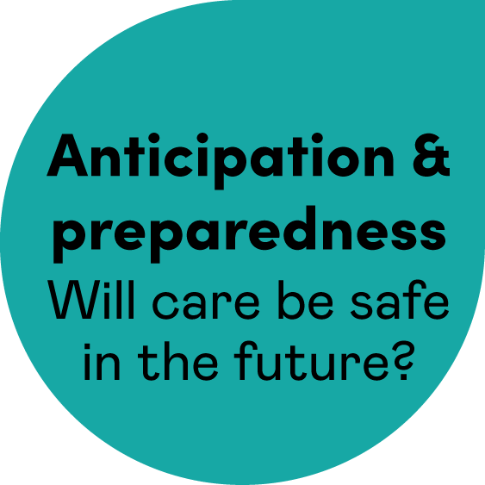
Anticipation & preparedness
Looking at other data sets differently
Horizon scanning to proactively identify emerging and future safety risks

Slide 53
Safety cloud theme 1: Looking at other data
sets differently
Reflective question
What other data sets might shine a light on the emerging patient and staff safety threats that our team or organization is facing?

Slide 54
Safety cloud theme 1: Looking at other data
sets differently
Background
Anticipation and preparedness can be enhanced when leaders look beyond what is traditionally presented as patient safety data in board and senior leadership reports.
All too often, the patient safety data that leaders are presented with focuses on patient harm – but safety is far broader than physical harm.
By looking at data sets not traditionally labeled as patient safety data, senior leaders can proactively identify what could go wrong, before an incident occurs.
Notes:
Anticipation and preparedness can be enhanced when leaders look beyond what is traditionally presented as patient safety data in board and senior leadership reports.
All too often, the patient safety data that leaders are presented with focuses on patient harm – but safety is far broader than physical harm.
By looking at data sets not traditionally labeled as patient safety data, senior leaders can proactively identify what could go wrong, before an incident occurs.
Since these data sets are already routinely reviewed by senior leaders, developing the habit of asking yourself, “What could be the impact on safety?” enables you to build the skill of scanning for and anticipating future safety risks.

Slide 55
Safety cloud theme 1: Looking at other data
sets differently
This safety theme cloud is asking you to
consider how other types of data you collect in your settings might inform your understanding of future safety risks.
Examples of other types of data:
client demographics and equity stratifiers
referral rates and wait times
leaving without being seen
access to diagnostic testing, beds and services
staff turnover, skill mix and sickness data
statutory and mandatory training compliance levels
Patient experience data, including compliments and concerns
Notes:
This safety theme cloud is asking you to:
consider how operational data might inform your understanding of future safety risks. These can include:
client demographics and equity stratifers
referral rates, wait times
leaving without being seen
access to diagnostic testing, beds and services
staff turnover, skill mix and sickness data
statutory and mandatory training compliance levels
or other types of data you collect in your settings
Additional questions from Rethinking Patient Safety to consider including in your discussion:
What does patient safety mean to you?
How is the presence of safety different from the absence of harm?
Do your safety metrics tell you how safe your care is or how lucky you have been?

Slide 56
Safety cloud theme 2: Horizon scanning to proactively identify emerging and future safety risks
Reflective question
How do we, as leaders, ensure that we spend time horizon scanning for emerging and future safety risks to gain insight into whether care will be safe in the future?

Slide 57
Safety cloud theme 2: Horizon scanning to proactively identify emerging and future safety risks
Background
Standards, guidelines and regulations for safety are important and necessary.
The Measurement and Monitoring of Safety report (Health Foundation, 2013), identified that, at times, healthcare organizations become so concerned about and focused on meeting standards, guidelines and regulations that they have little bandwidth to think critically, foster the desired safety culture or engage in horizon scanning to proactively identify emerging or future risks to safety.

Slide 58
Safety cloud theme 2: Horizon scanning to proactively identify emerging and future safety risks
This safety theme cloud is asking you to:
reflect on what happens in your organization – How does your organization think critically about patient safety issues, make efforts to create the desired patient safety culture or proactively identify emerging or future risks to safety?
share how you do or might create capacity to answer the question, “Will care be safe in the future?”
Notes:
Additional questions from Rethinking Patient Safety to consider including in your discussion:
How have you approached safety in the past?
How might you approach it differently now?
What could you start doing?
What could you stop doing?

Slide 59
How can we better answer the question, “Will care be safe in the future?”
Notes:
Now that you have explored Anticipation & Preparedness, and have completed the two anticipation and preparedness safety theme clouds:
Refer to your notes from the discussion on - How do we currently answer the question “Will care be safe in the future?”
Now think and reflect on the question - How can we better answer the question “Will care be safe in the future?”

Slide 60
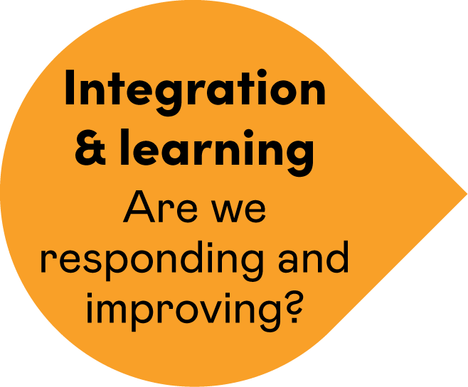
Integration & learning

Slide 61

Integration & learning:
Are we responding and improving?
Integration & learning is the development of systems to promote a cycle of learning and sharing from safety incidents, multiple sources of safety intelligence and insights developed through the other domains.
Please don’t let this become the lost piece of the puzzle.
Plan how you are going to integrate information and metrics, and what channels for learning and improvement you have in place.
A learning system is a safe system!
Notes:
The Integration and Learning dimension has us asking whether we are improving and learning: After all, a learning system is a safer system.
This domain focuses on developing systems to promote a continuous cycle of learning and sharing – not just from safety incidents, but from multiple sources of safety intelligence across all other domains.
Important points about integration and learning:
Integration and learning is the scaffolding for the other domains.
We have made progress in reporting, responding and learning from harm, but true integration and learning needs to move beyond learning from harm and proactively improve safety.
Safe organizations not only report and learn from patient safety incidents, but also actively seek insights from the other domains and respond with inquiry, listening, learning and sharing .
Organizations need to determine:
how to gather and integrate patient safety information from multiple sources
and then determine how to use the information to drive meaningful improvement

Slide 62
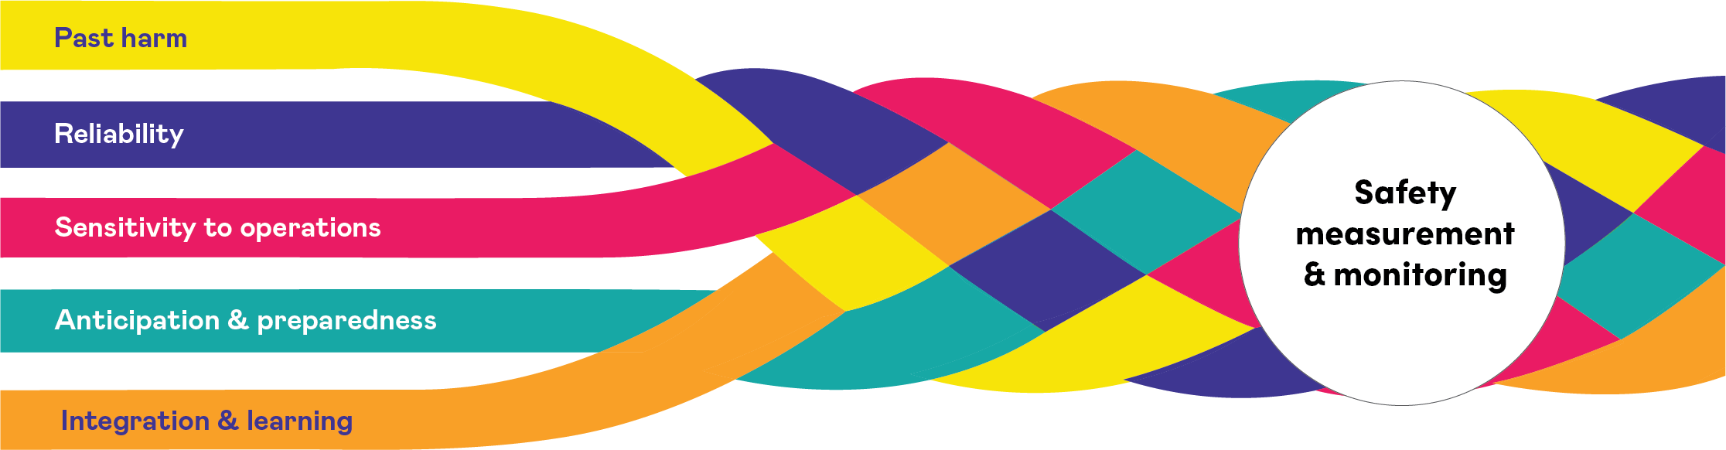
Expanded and shared understanding of “what is safety”
Notes:
Integration and learning is like weaving together five strands of thread to create strong rope. When we interweave all five dimensions of safety, we create a much safer system.
The Measurement and Monitoring of Safety Framework provides an expanded and shared understanding of “what is safety.”

Slide 63
How do we currently answer the question, “Are we responding and improving?”
Notes:
Following a brief introduction to Integration and Learning
Think and reflect on the question - How do we currently answer the question “Are we responding and improving?”

Slide 64
Integration
& learning
Knowing how feedback and learning happens
Preventing integration fog

Slide 65
Safety cloud theme 1: Knowing how feedback and learning happens
Reflective question
How do we, as leaders, get assurance that what is learned from safety investigations and audits is fed back to point-of-care healthcare teams in a way that supports learning and improvement?

Slide 66
Safety cloud theme 1: Knowing how feedback and learning happens
Background
Healthcare organizations often struggle with how to effectively share learning from incident investigations, safety audits, walking rounds and safety culture surveys. The challenges lie in ensuring that feedback reaches the right teams in a meaningful way and that it is shared more broadly across the organization.
Common problems include:
we tell staff the outcome of an audit or investigation and expect improvement to occur.
safety learning is not shared with ‘hard to reach’ groups
we share findings without contextualizing the learning in a way that helps staff to learn
we feedback the learning to the team involved in the incident, without sharing more broadly across the organization
Notes:
Background: Healthcare organizations often struggle with how to effectively share learning from incident investigations, safety audits, walk-rounds and safety culture surveys. The challenges lie in ensuring that feedback reaches the right teams in a meaningful way and that it is shared more broadly across the organization. Specific challenges include:
Simply informing staff of the outcome of an audit or investigation and expecting improvement to occur.
Failing to reach “hard-to-access” groups such as staff who do not access emails or the intranet, staff who work night shifts and staff without a local office).
Sharing findings without context or engagements strategies, such as storytelling or case vignettes, to make the learning more impactful.
Limiting feedback to the team involved in an incident without sharing it more broadly across the organization, particularly in areas where similar risks may exist.

Slide 67
Safety cloud theme 1: Knowing how feedback and learning happens
This safety theme cloud is asking you to:
reflect on the approaches you use to feed back learning to teams in your organization
reflect on how learning is fed back and identify any gaps in feedback loops or how you could check-in with teams to determine if the learning has been understood and they are supported to implement changes.

Slide 68
Safety cloud theme 2: Preventing integration fog
Reflective question
How might we triangulate and integrate patient safety data in a way that does not make it difficult for senior leaders to understand what the data is telling them?

Slide 69
Safety cloud theme 2: Preventing integration fog
Background
Healthcare leaders sometimes face an avalanche of patient safety metrics and information.
This overload of information, or “integration fog”, can obscure meaningful insights.
Healthcare organizations sometimes continue to use outdated safety metrics and approaches even when more relevant safety data is available.
When colour-coded data (red, amber and green) draw attention only to high-risk (red) areas, leaders may overlook broader safety trends.
Cutting through the fog requires a thoughtful approach to selecting, presenting, discussing and integrating safety data.
Notes:
Background
Healthcare leaders sometimes face an avalanche of patient safety metrics and information – from dashboards and scorecards to board and senior leadership meeting papers. This overload of information, or “integration fog”, can obscure meaningful insights, making it hard for leaders to interpret and act on safety data effectively.
Meanwhile, healthcare organizations in many cases continue using outdated safety metrics and approaches when more relevant safety data is available. And when color-coded data (e.g. red, amber, green) draw attention only to high-risk (red) areas, leaders may overlook broader safety trends. Cutting through this fog requires a thoughtful approach to selecting, presenting, discussing and integrating safety data.

Slide 70
Safety cloud theme 2: Preventing integration fog
This safety theme cloud is asking you to:
Reflect on how your organization’s patient safety data is integrated and presented.
Have a reflective conversation about how you, as leaders, navigate through your safety dashboards and safety reports.
Ask the question, “Is there integration fog?” If yes, how could the data or reports be presented?

Slide 71
How can we better answer the question, “Are we responding and improving?”
Notes:
Now that you have explored Integration & learning, and have completed the two “Integration & Learning” safety theme clouds:
Refer to your notes from the discussion on - How do we currently answer the question “Are we responding and improving?”
Now think and reflect on the question - How can we better answer the question “Are we responding and improving?”

Slide 72
Continuing your safety journey
Schedule regular safety discussions with your leadership team
Revisit specific safety clouds or create new safety clouds as challenges and opportunities emerge
Use this activity and workbook to welcome and guide new leaders in your organization’s safety journey
Share insights from your safety cloud discussions broadly within your organization
Explore additional safety activities available to support your organization’s journey toward Rethinking Patient Safety.
Notes:
You've now explored each safety cloud and reflected on the key question it asks:
Past harm – Has care been safe in the past?
Reliability – Are our clinical systems and processes reliable?
Sensitivity to operations – Is care safe today?
Anticipation & preparedness – Will care be safe in the future?
Integration & learning – Are we responding and improving?
Like the braided rope illustrated on slide 62, these domains work together to create safer care. Each strand strengthens the others. Your reflections and insights can now become catalysts for meaningful change in your organization.
We encourage you to continue your safety journey towards Rethinking Patient Safety. Here are some suggestions for doing this:
schedule regular safety discussions with your leadership team
revisit specific safety clouds or create new safety clouds as challenges and opportunities emerge
use this workbook to welcome and guide new leaders in your organization’s safety journey
share insights from your safety cloud discussions broadly within your organization
Explore additional safety activities available to support your organization’s journey toward Rethinking Patient Safety. – the next slide includes some additional resources for you to consider.

Slide 73
Additional resources
Rethinking Patient Safety
The measurement and monitoring of safety
Measurement and monitoring of safety through the eyes of patients and their care partners
Effective Governance for Quality and Patient Safety: An eight module, self-directed learning program
Patient Safety Essentials: A six module, self-directed learning program
EXTRA™: Executive Training Program

Slide 74
Acknowledgment
This slide deck was prepared by Healthcare Excellence Canada for use by healthcare organizations to inspire reflection and discussion around current approaches for measuring and monitoring safety in all sectors of healthcare.
Healthcare Excellence Canada (HEC) works with partners to spread innovation, build capability, and catalyze policy change so that everyone in Canada has safe and high-quality healthcare. Through collaboration with patients, caregivers and people working in healthcare, we turn proven innovations into lasting improvements in all dimensions of healthcare excellence. Launched in 2021, HEC brings together the Canadian Patient Safety Institute and Canadian Foundation for Healthcare Improvement. HEC is an independent, not-for-profit charity funded primarily by Health Canada. The views expressed herein do not necessarily represent the views of Health Canada.

