Slide 1
Activity: Comic Strip Conversation
Reflecting on reliability by reconciling
“Work as Imagined” and “Work as Done”
Notes:
If conducting this activity with a large audience begin by organizing your participants into groups of about eight. Each group of eight must include both those who do the work/deliver care (work as done) and those who set policy and seek assurance (work as imagined).

Slide 2
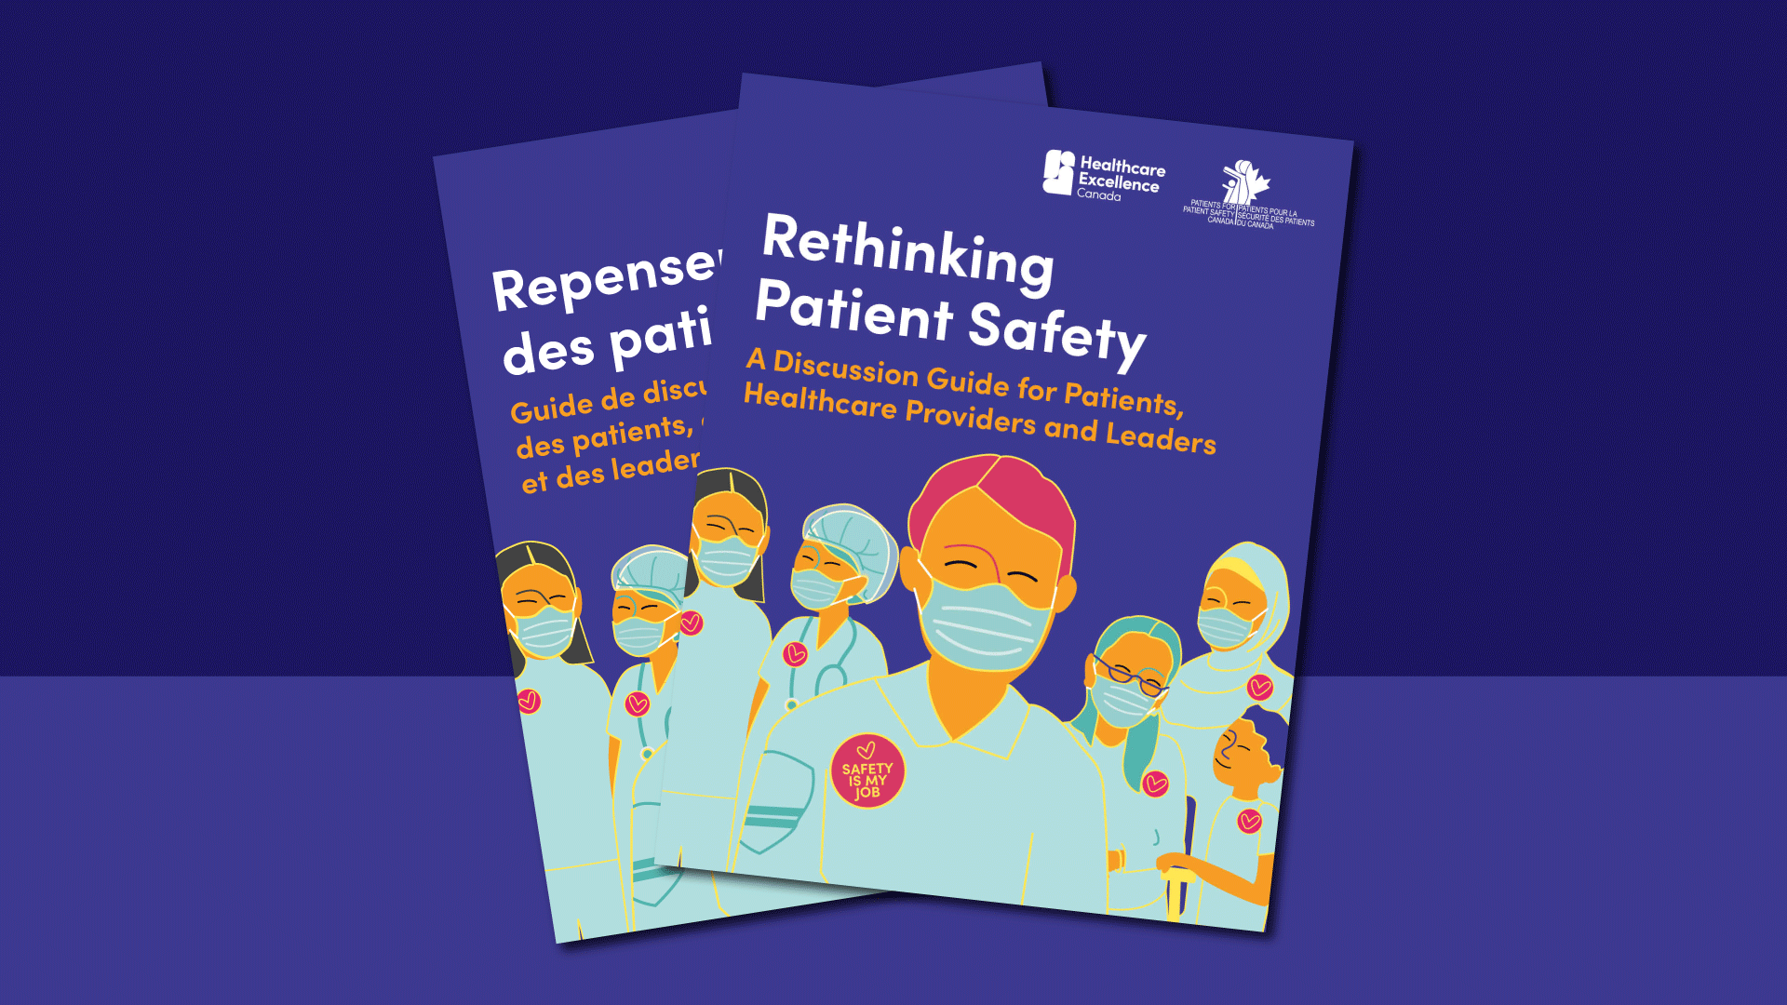
Rethinking Patient Safety (healthcareexcellence.ca)
Notes:
This activity is part of the Rethinking Patient Safety initiative, which encourages teams to explore the reliability domain of the Measuring and monitoring of safety framework.
Rethinking Patient Safety (Healthcare Excellence Canada, October 2023) recognizes that safety is more than the absence of harm. It encourages teams to think differently about how safety is defined, measured and discussed. This shift creates the foundation for exploring work as imagined and work as done.
Additional notes (optional)
Rethinking Patient Safety was released in 2023 by Healthcare Excellence Canada. It was developed because despite 20 years of efforts to improve patient safety, we haven’t been as successful as we had hoped. Healthcare Excellence Canada is encouraging everyone to rethink how they have been defining and approaching patient safety improvement work.
The core statement within Rethinking Patient Safety reads:
“Everyone contributes to patient safety. Together we must learn and act to create safer care and reduce all forms of healthcare harm.”
It includes a table for reflection and a list of questions for discussion.
Rethinking Patient Safety arose from HEC’s implementation of the Measurement and Monitoring of Safety Framework (Vincent, Burnett, Carthey, 2013).
For more information about Rethinking Patient Safety, please refer to the link on the slide.

Slide 3
Measurement and Monitoring of Safety Framework
The measurement and
monitoring of safety –
The Health Foundation
Notes:
The Measurement and Monitoring of Safety Framework provides a conceptual model to healthcare organizations in their efforts to improve safety. The nature of safety has been discussed in the wider literature but, in healthcare at least, there has been little consensus on the core dimensions of safety or what exactly should be measured and monitored. The MMSF captures and integrates all the critical dimensions of safety in one framework and provides examples of how these various concepts might be realized in practice within organizations across health sectors, from acute care and rehabilitation, long term care, home and community care.
The MMSF attempted to synthesise the wider theory, literature and practice from both healthcare and other industries in a form that aimed to be accessible and useful to all healthcare organizations. The Framework comprises five dimensions or lenses on safety; past harm. reliability, sensitivity to operations, anticipation and preparedness, and integration and learning.
For more information about the Measurement and Monitoring of Safety Framework, please refer to the link on the slide

Slide 4
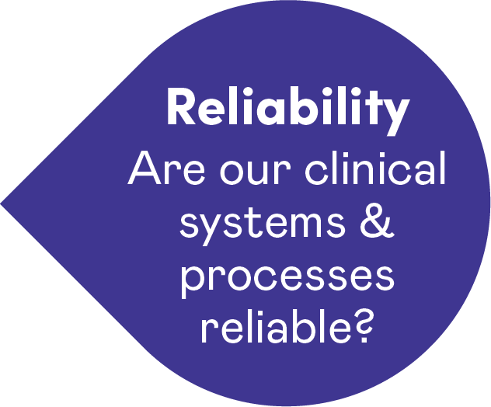
Reliability
Notes:
The focus of our discussion and activity is going to take a deep dive into the Reliability dimension of the MMSF.
Reliability helps us examine how consistently work is carried out as intended, and how gaps between expectations and real practice emerge.

Slide 5
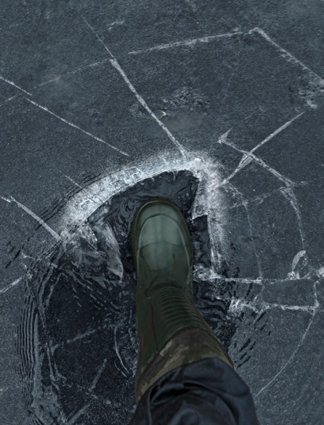

Reliability – Are our clinical systems and processes reliable?
Reliability is gauging the probability that a task, process, intervention
or pathway will be carried out or followed as specified.
What would happen if we had
a system of only measuring the number of people who fell through the ice rather than measuring the thickness of the ice?
Notes:
Reliability – Are our clinical systems and processes reliable?
This dimension poses the question: are our clinical systems and processes reliable and, if they are not, what might that mean for the safety of the patient?
What is reliability?
“Failure-free operation over time” applies mostly in technology.
“Gauging the probability that a task, process, intervention or pathway will be carried out or followed as specified.”
In healthcare, we must recognize that variation is necessary given differences in patients and in care environments; treatments are adapted to fit patient needs.
Sources of poor reliability include staff skills and experience and team factors, including poor communications, inadequate design of clinical environments and supports systems, and the view by clinical staff that systems are unreliable – and it is not their role to ensure reliability.
Examples of reliability measures-
hand hygiene
the timely administration of pre-operative antibiotics
the timely ordering of diagnostic tests
medication review and reconciliation
surgical checklists
availability of clinical information / patient records
availability and efficient functioning of equipment
administration of radiotherapy
availability of supplies
on-time visits
continuity of care- how often patients/clients receive care from the same provider
completion of staff training/continuing education

Slide 6
Unintended consequences of measuring reliability

Slide 7
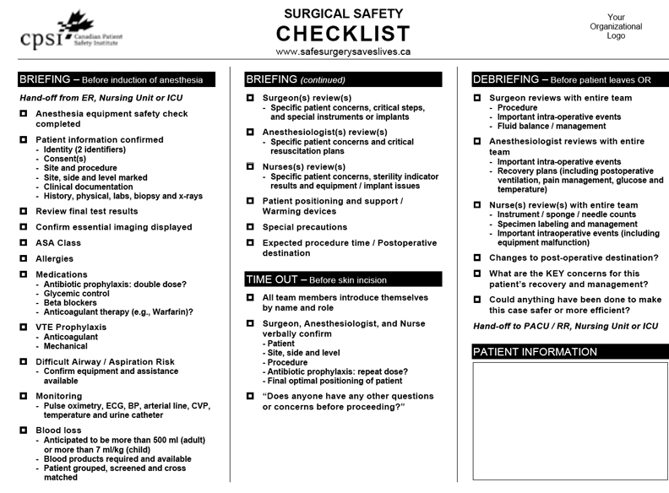
Measures of reliability
Do your measures of reliability measure what you intend to
or are they simply audits of documentation?
Do your measures of reliability give you and others a false assurance of safety?
Do your measures of reliability sometimes create involuntary automaticity, aka tickbox“itis”?
Notes:
Do your measures of reliability actually measure what you intend to or are they simply audits of documentation?
For example:
The surgical checklist is designed to be used before, during and after surgery to identify potential risks and reduce errors through improved teamwork and communication. But do your surgical checklist reliability measures actually assess teamwork and communication – or are they simply an audit of whether the checklist was completed?
Do your measures of reliability give you and others a false assurance of safety?
Example: Consider hand hygiene audits. Many regions across Canada require facilities to conduct audits and publicly report compliance.
A recent review of publicly reported data showed that in Ontario, hand hygiene compliance before patient contact was reported at 85.3 percent, and after patient contact, 90.2 percent. Some facilities even reported 100 percent compliance.
But do these numbers truly reflect reality? Do they drive improvement, or do they simply create a false sense of security that care is safe?
Do your measures of reliability sometimes create involuntary automaticity – also known as “ticbox“itis”?
Are your staff burdened with so many checklists and forms that documentation becomes a mindless, automatic task?
As they complete charting, does habit take over?
The next slide will illustrate the overwhelming number of checklists and documents a mental health nurse must complete in a single shift.
Slide adapted from Jane Carthey & Sarah. Garrett presentation: MMSF Safety Improvement Collaborative LS2 March 2019 .

Slide 8
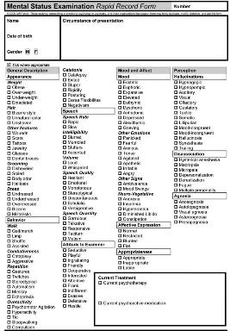
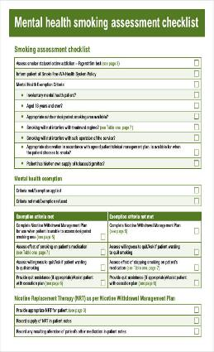
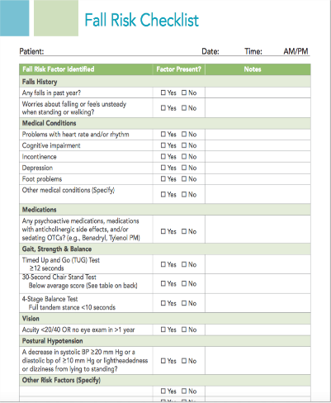
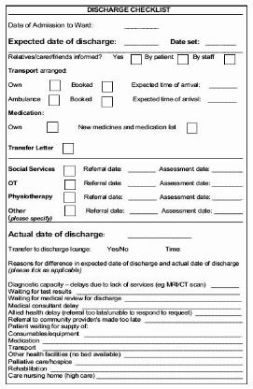
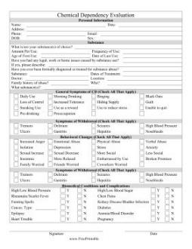
Undermining reliability in mental health
“We have checklists for violence and aggression, self-harm, suicide, physical health, falls, risk of absconding, smoking assessment. Discharge. It goes on and on … and means we spend less time talking to and observing patients.”
– Mental health nurse 1
MMSF Safety Improvement Collaborative LS2 March 2019 – J. Carthey / S. Garrett
Notes:
This quote illustrates the documentation burden faced by mental health nurses.
Read or paraphrase these to the group, then ask:
"Does this resonate with your experience? How does documentation load affect your ability to focus on patient care?“
Slide adapted from Jane Carthey & Sarah. Garrett presentation: MMSF Safety Improvement Collaborative LS2 March 2019 .

Slide 9


Measures of reliability continued
  Do your measures of reliability distract you sometimes and
  cause us to miss the obvious?
  Does your approach to measuring
  reliability contribute to people feeling psychologically unsafe?
Notes:
Do your measures of reliability sometimes distract you and cause you to miss the obvious?
Let me share a story that illustrates this point.
In a long-term care home, staff were highly focused on documenting and treating a pressure injury. They followed every protocol and were fully compliant. But in focusing so narrowly on this task, they missed early signs of pneumonia, and the resident later became septic and required emergency transfer. The ED physician noted this happens often. This illustrates how an emphasis on measured tasks can draw attention away from broader assessment and the safety of our patients and residents.
Does our approach to measuring reliability make people feel judged and psychologically unsafe?
We also need to ask whether our measurement approach makes people feel judged. When things go wrong, we tend to add more rules, more policies, more audits. But this often places blame on individuals rather than improving systems. As Mate, Clark and Salvon-Harmon wrote in 2024, ‘The systems need fixing far more than the people.’ Reliability work should support staff, not add burden or fear.
Reference: Mate, K. S., Clark, J., & Salvon-Harman, J. (2024, July 12). To improve health care, focus on fixing systems — not people. Harvard Business Review. https://hbr.org/2024/07/to-improve-health-care-focus-on-fixing-systems-not-people

Slide 10


Do your measures of reliability contribute to a preoccupation with
the work of safety?
the safety of work?
Instead of
Notes:
And sometimes we can get so caught up in trying to make sure our systems and processes are reliable; we lose sight of the difference between the work-of-safety and the safety of work.
Additional background material:
Work of Safety – Activities such as checking compliance with policies and procedures, conducting audits of workplace behaviour, and recording and reporting deviations. There is no compelling empirical evidence that these types of activities, on their own, improve safety outcomes. In many cases, they can leave workers feeling disenchanted and disempowered.
Example of Work of Safety: Monitoring compliance
Justification for the activity: To control or monitor behaviour through surveillance, audits, and policies.
Reason for disenchantment: Workers may revert to their usual practices when they are not being observed.
Safety of Work –it is distinct and different from the work of safety. Safety of work is created by those who do the work.
Example of something people working in safety departments can do to support the Safety of Work: Learning about everyday work-as-done
How to do this: Engage with workers, build trust, and seek to understand how work really gets done.
Why do this: To discover how safety is created in everyday practice and to learn about the obstacles and difficulties workers face while trying to achieve their goals.
Work of safety activities are not irrelevant—they play a role in keeping organizations operating. However, it is important to be honest about whether there is a preoccupation with the work of safety, rather than the safety of work.
(Dekker & Conklin, 2014. Do Safety Differently)
Additional references:
Do Safety Differently - Sidney Dekker and Todd Conklin
https://safetyofwork.com (Podcast with many episodes)
https://sidneydekker.com/safety-anarchist

Slide 11
Dilemma
Reliability is critical to safety
BUT
How do we improve our approach to measuring and monitoring reliability?
How do we improve reliability?
Notes:
Pause here to acknowledge the tension. Reliability matters – but our current approaches to measuring it may not be working as intended.

Slide 12
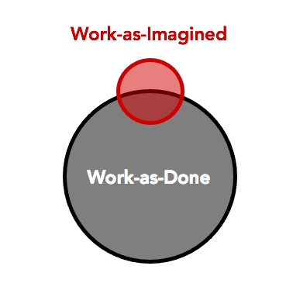

Work as imagined vs. work as done:
MIND THE GAP
Notes:
Who has heard of the concepts work as imagined and work as done? Work as imagined is what policies and procedures say should happen. Work as done is what actually happens in real clinical conditions.
We often assume safety means making work as done match work as imagined, but real environments are too complex for that to be fully true. Staff must adapt constantly – and these adaptations are usually what keep patients safe. We can only improve safety if we understand the reality of work as done.
Furthermore , despite our best intentions, our efforts to enforce work as imaged through adding in more guidelines, checklists, audits, can sometime distract from the safety of work.
Extra background (optional reading and resources for the facilitator)
It is believed that safety can be achieved by ensuring that work as done is made identical to work as imagined. But the more intractable environments that we have today means that work as done differs significantly from work as imagined. Since work as done, by definition, reflects the reality that people have to deal with, the unavoidable conclusion is that our notions about work as imagined are inadequate, if not directly wrong. A practical implication of this is that we can improve safety only if we get out from behind our desk, out of meetings and into operational and clinical environments with operational and clinical people.
The way we think of safety must correspond to work as done and not rely on work as imagined – and ask why things go right (or why nothing went wrong) – and then try to make sure that this happens again. (Hollnagel E., Wears RL., Braithwaite J. (2015) From Safety-I to Safety-II: A White Paper, page )
Work as imagined
Work-as-imagined is both the work that we imagine others do and the work that we imagine we or others might do, currently or in the future. The imagination of human work takes place within organizations, between organizations, and from outside of organizations (for example, by regulators, accreditation bodies and government agencies) (Shorrock, 2016)
Work as done
Work as done is actual activity – what people do. It takes place in an environment that is often not as imagined, with multiple, shifting goals, variables and often unpredictable demand, degraded resources (staffing, competency, equipment, procedures and time) and a system of constraints and incentives, which can all have unintended consequences. Work as done is mostly achieved by adjustments, variations, trade-offs and compromises that are necessary to meet demand. These adaptations are based on operational knowledge, but often have not been subject to formal analyses such as risk assessment Such analysis struggles to handle them (Shorrock 2016).
Additional resource:
Do Safety Differently – https://sidneydekker.com/do-safety-differently

Slide 13
Work as imagined and work as done
The blunt end
Work as imagined
The sharp end
Work as done
[Hollnagel, 2015]
Notes:
Slides adapted Jeffrey Braithwaite Presentation: New and emerging trends in Quality Improvement and Patient Safety: preparing for the future – Presented at the Atlantic Learning Exchange, October 2019.

Slide 14
The blunt end tries to…
Shape, influence and nudge behavior
Notes:
Because it is believed that safety can be achieved by ensuring that work as done is identical to work as imagined.
Over the next few slides, you’ll see some familiar ideas from traditional safety thinking. These models shaped how many of us were trained to understand safety: keep things controlled, keep variation low and assume that predictability leads to safety. They’re useful, but they don’t always fit the realities of our care environments.
Slides adapted Jeffrey Braithwaite presentation: New and Emerging Trends in Quality Improvement and Patient Safety: preparing for the future

Slide 15
In healthcare, those doing
WORK AS IMAGINED have designed, instructed or encouraged a range of tools, techniques and methods to reduce harm to patients
Notes:
Slides adapted Jeffrey Braithwaite Presentation: New and emerging trends in Quality Improvement and Patient Safety: preparing for the future

Slide 16
These methods and approaches appear perfectly logical, obvious, and feasible
Notes:
Linear models try to simplify what happens in day-to-day clinical work. In practice, of course, the work isn’t linear. It’s messy, constantly shifting and full of competing demands. Understanding that complexity is essential if we want our safety efforts to reflect what teams actually face.
Slides adapted Jeffrey Braithwaite Presentation: New and emerging trends in Quality Improvement and Patient Safety: preparing for the future

Slide 17
Meanwhile, at the point of care…
Braithwaite et al., 2017
Notes:
Assumptions about standardization and control can create gaps between policy and practice. When systems expect work to run smoothly and predictably, but staff are working in unpredictable conditions, those gaps grow. That tension is at the heart of why work as imagined and work as done drift apart.
Refer to Appendix B of the Activity Card Instructions for examples to highlight work as imagined and work as done.
Slides adapted Jeffrey Braithwaite Presentation: New and emerging trends in Quality Improvement and Patient Safety: preparing for the future
Image source – Braithwaite, J., Churruca, K., Ellis, L. A., Long, J., Clay-Williams, R., Damen, N., Herkes, J., Pomare, C., and Ludlow, K. (2017) Complexity Science in Healthcare – Aspirations, Approaches, Applications and Accomplishments: A White Paper. Australian Institute of Health Innovation, Macquarie University: Sydney, Australia. Braithwaite-2017-Complexity-Science-in-Healthcare-A-White-Paper-1.pdf

Slide 18

Do your best to reconcile work as imagined and work as done
Notes:
Rather than adding more rules or more compliance tasks, what we’re encouraging is a shift: let’s understand the gap between work as imagined and work as done and then work to reconcile it. When we do that, we see opportunities to improve systems instead of placing more burden on staff.
Slides adapted Jeffrey Braithwaite Presentation: New and emerging trends in Quality Improvement and Patient Safety: preparing for the future

Slide 19
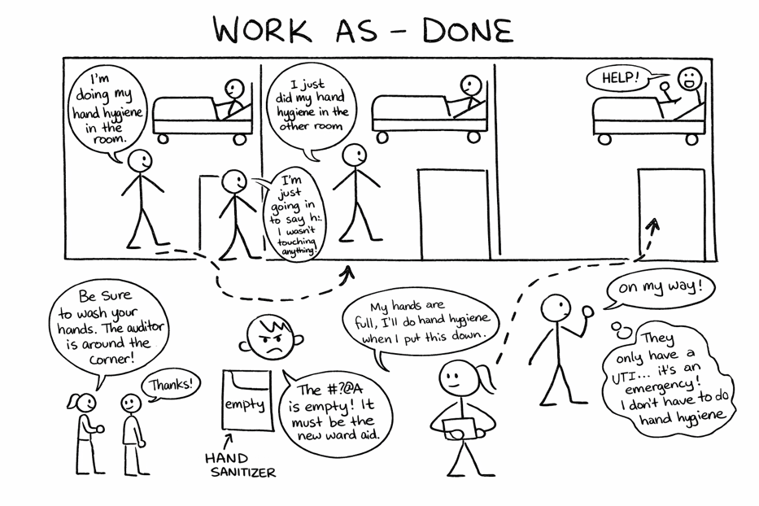
Activity: Comic strip conversation
Recognizing and reconciling
work as imagined and work as done
Notes:
To explore this idea in a hands-on way, we are going to do an activity called a comic strip conversation.

Slide 20
What is a comic strip conversation?
An approach to visually tell a story
We will be using this approach to tell our story
and capture insights into:
  work as imagined
  work as done
The comic strips we create will serve as the foundation for reflection and discussion between the two groups.
Notes:
A comic strip conversation is a simple approach to visually tell a story. Because it's visual, it's surprisingly effective at helping teams compare the "official" version of work (which is work as imagined) with the everyday version (which is work as done). The goal with the comic strips is to surface insights and spark meaningful discussion.

Slide 21
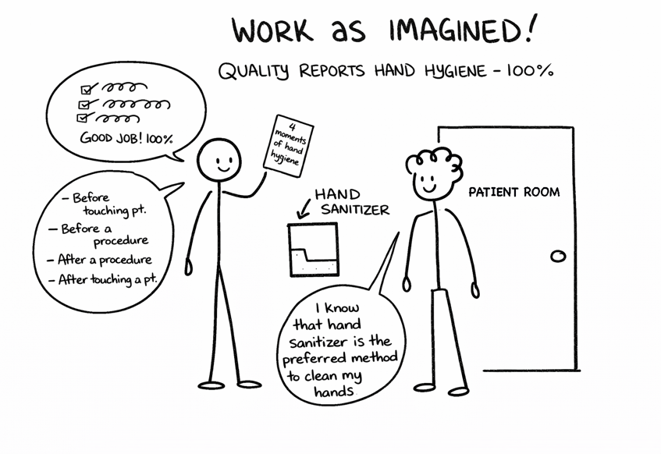

Example: Comic strip conversation about hand hygiene compliance
Work as imagined
Work as done
Notes:
Here is how a comic strip conversation can play out. Notice that the stick figures are simple. Nobody needs to be an artist!
And notice how differently the two sides interpret the work at hand.
Optional - Consider delving into the details of the comic strips, describing them a little. What do we see in each one? What are the strengths? What are the gaps?

Slide 22
Why have a comic strip conversation
The activity supports those who manage care and those who deliver care to:
  uncover and reflect on the gaps between work as imagined and work as done
  discuss potential unintended consequences surrounding efforts of ensuring reliability (see to slides 6–10)
  work towards bridging the gap between work as imagined and work as done
  move beyond compliance-driven safety strategies toward more meaningful solutions
Notes:
Here is what we know about comic strip conversations: This activity brings together those who manage care and those who deliver it. By creating and sharing comic strips, we build a shared understanding of where official processes and real-world practice diverge. From there, we can have honest conversations about whether our reliability measures are helping or getting in the way — and start thinking about what would actually make care safer.

Slide 23
Select or describe the healthcare process
If you have pre-selected a specific policy or process to focus your discussion on, use this slide and time to introduce it to the participants.
If you opted to let participants select their own policy or process, give them time
to discuss options and
select one.
Use this slide to include some examples for them to consider.
Notes:
Select the healthcare process:
If you have pre-selected a specific policy or process to focus your discussion, use this time to introduce it to the participants.
If you opted to let participants select their own process, give them time to discuss options and select one.
Another option is to use dotmocracy to help select one process from a list of options.

Slide 24
Activity: Comic strip conversation instructions
Organize yourselves at your table into two groups:
  Work as imagined – e.g. board members, middle or senior managers
  Work as done – point-of-care healthcare team – those who deliver care on a day-by-day basis
Notes:
Ask each group of eight to organize themselves into two groups: those who set policy and seek assurance (work as imagined) and those who do the work/deliver care’ (work as done).

Slide 25
Create your comic strip conversation
Work as imagined group: Imagine you are sitting in a meeting discussing XXX
Work as done: Imagine you are delivering care today
Thinking about the:
  pain points
  barriers
  adaptations you make when delivering care related to XXX process
Thinking about:
  What is written in the policy?
  What data do you receive on the XXX healthcare process?
  What does your audit data tell you?
Use a comic strip conversation to map out how XXX process is performed at your organization.
15 minutes
Notes:
The work as imagined group creates a comic strip that captures the official process as described in the policy and procedure, the audit approach and audit results. A question to frame this conversation could be something like, “Imagine you are sitting on the safety committee in your organization. What data do you receive on the chosen healthcare process? What do the audits results tell you?”
The work as done group illustrates how the same healthcare process unfolds in real-world conditions, such as on a unit, in a patient’s home, residential care home or community. This group considers the pain points, barriers, and adaptations and trade-offs they make when delivering care relating to the chosen healthcare process. A question to frame this discussion could be something like, “Imagine you are working a shift today, what are the pain points/barriers and adaptations you have to make when carrying out the healthcare task your table is focusing on?”

Slide 26
Share, compare and discuss
Is there a disconnect between what is documented versus how care is delivered in the real world?
If so, what are the gaps between work as imaged and work as done
Do you think it is possible for staff to deliver XXX process
100 percent as written, 100 percent of the time?
Do you think your audit results best match work as imagined
or work is done?
15 minutes
Notes:
Share, Compare and Discuss – Once both groups have developed their comic strips, they come together to present them. The share and compare conversation should focus on the gaps between work as imagined and work as done. Some guiding questions for the groups to consider are:
Is there a disconnect between what is documented versus how care is delivered in the real world?
If so, where are the gaps?
Do you think it is possible for staff to deliver the process 100 percent as written, 100 percent of the time?
Do you think your audit results best match work as imagined or work is done?

Slide 27
Unintended consequences of reliability measures
1. Identify the reliability measures associated with the process you selected that are used by your organization (or team).
2. Think about the examples of unintended consequences of reliability measures:
  Are there any unintended consequences linked to how you currently measure and monitor XXX process?
  If so, what are they?
10 minutes
Notes:
As a team, identify the reliability measures associated with the process you selected.
Discuss potential unintended consequences of those reliability measures. Think about the examples of unforeseen consequences of reliability measures (slides 6-10). Ask the group, “Are there any unintended consequences to how you are measuring and monitoring the healthcare process you have focused on? If so, what are they?”

Slide 28
Strategies and solutions
  Given what you have discovered, what could you do differently in the future to improve the reliability of the process?
  In what ways could your organization improve its approach to measuring and monitoring this process?
10 minutes
Notes:
Now that the gap between work as imagined and work as done have been explored, and you have potentially identified some unintended consequences of measuring reliability:
Brainstorm:
Ways to reduce the gap between work as imagined and work as done
Ways in which your organization could better answer the question, “Is xx process safe and reliable?”
Here are some guiding questions for the group to conder:
Given what you have discovered, what could you do differently in the future to improve the reliability of the process?
In what ways could your organization’s approach to measuring and monitoring the healthcare process improve?

Slide 29
Debrief
  What gaps did you uncover between work as imagine and work as done?
  What unintended consequences did you uncover?
  What strategies and solutions did you come up with?
  What actions do you plan to take?
15 minutes
Notes:
Following the activity, debrief with participants by asking for volunteers to share what they discussed, what they learned and actions they plan to take.
As the facilitator, summarize what was heard and add any key messages not covered.

Slide 30
Before you leave, please share…
What did you learn?
Share your “Aha” moment(s)
Your ideas – What is one thing you will do to action what you learned today?
What went well?
Even better if…
5 minutes
Notes:
To evaluate the session consider asking participants these questions:
What did you learn? Share your Aha moment(s)
Your ideas - What is one thing you will do to action what you learned today?
What went well?
Even Better if…
One method for gathering feedback is to write each question on a sheet of flip chart paper and post them on the wall. Have participants write their responses on sticky notes and place them on the corresponding flip chart.

